Slide 1
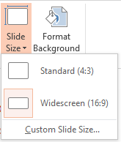
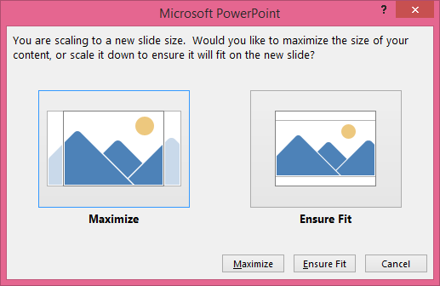
Showcard Gothic 48 pt.
Chiller 44 pt.
Chiller 40 pt.
Chiller 36 pt.
Chiller 32 pt.
Master Slide & Layouts Customized
Custom Font Theme
Using Standard MS Fonts (same issue with non standard fonts)
Custom Color Scheme
Adjusted width of Title and content text boxes
Template Created Using Office 365, 32Bit Install
Repro Steps
Design Tab
Slide Size
Standard 4:3
Ensure Fit (if dialog appears)
Result = base MS template customization removed
Email screen capture of your conversion to Troy
2
OUR RESULT
Original 16:9
Converted to 4:3
3
4

