Slide 1
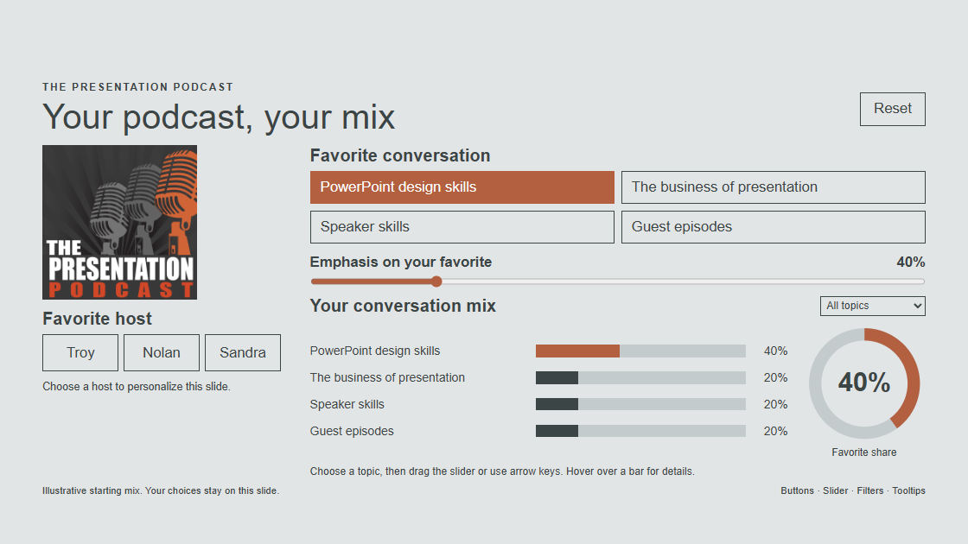
Your podcast, your mix
Notes:
This demonstration lets listeners choose a favorite host and shape their own conversation mix. The starting mix is illustrative, not audience survey data. The chosen topic receives the slider percentage and the other three topics share the remainder equally. Rounded labels may total 99 or 101 percent. Host choices do not imply host expertise or change the topic mix.
Using this slide:
Click Troy, Nolan or Sandra. Choose a conversation topic and move the emphasis slider, or use arrow keys. Select Focus on favorite to de-emphasize the other chart bars. Hover or focus a bar for a tooltip. Click a bar to select that topic. Press Control to dismiss a tooltip. Reset restores the initial mix and clears the host. Choices are local to this slide and are not submitted or retained as survey results. The static preview shows the initial mix.
Sources: https://thepresentationpodcast.com/ and the user-provided logo. Host names and conversation categories follow the user brief. Template geometry and typography follow the current presentation.

